Slide 1
PROJECT PRESENTATION
K. Sai Akhil
1602-18-735-093

Slide 2
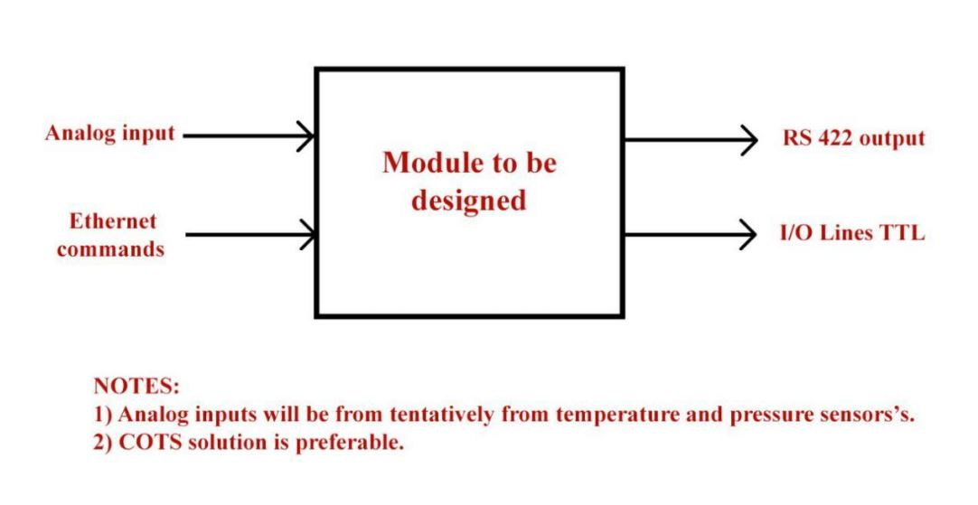
PROBLEM STATEMENT BY AN ALUMNI WORKING AT BHEL
Design a module that takes Analog inputs, like temperature and pressure, along with ethernet commands from user to transmit the input data into a minimum of 20 TTL lines and RS232 outputs.

Slide 3
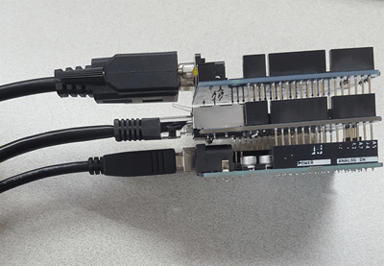
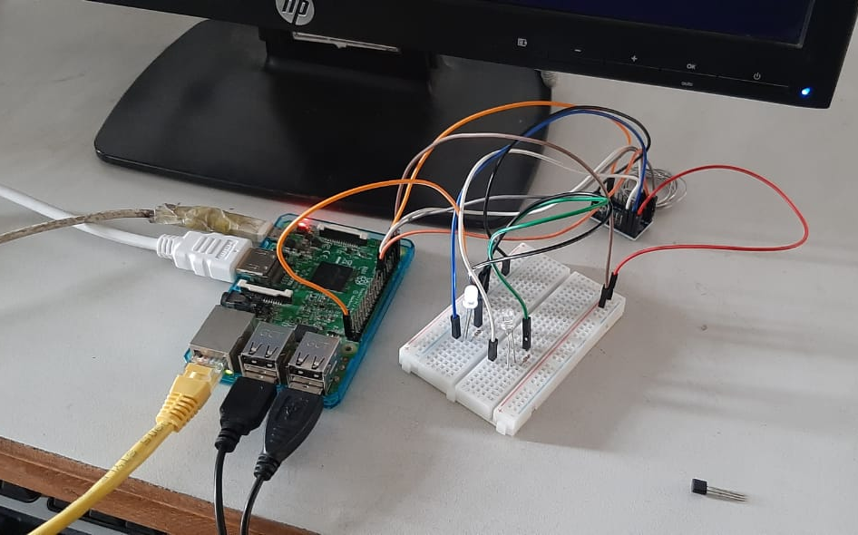
POSSIBLE Approaches
Arduino UNO + PHPOC Shield
Raspberry PI 3 + Convertors + PI-HAT
We’ve used the second method for its computation power and its convention to adapt to changes in requirement or further development.

Slide 4
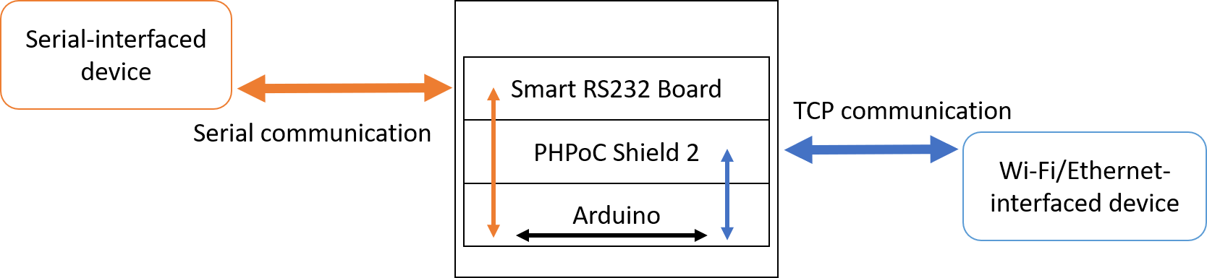
The First Approach
The former proposed idea of mine was sufficing but it got rejected for its computation power.
As the module had to be a COTS product, we had to isolate it. For this reason, we moved to buying a high end development board along with necessary attachments.

Slide 5
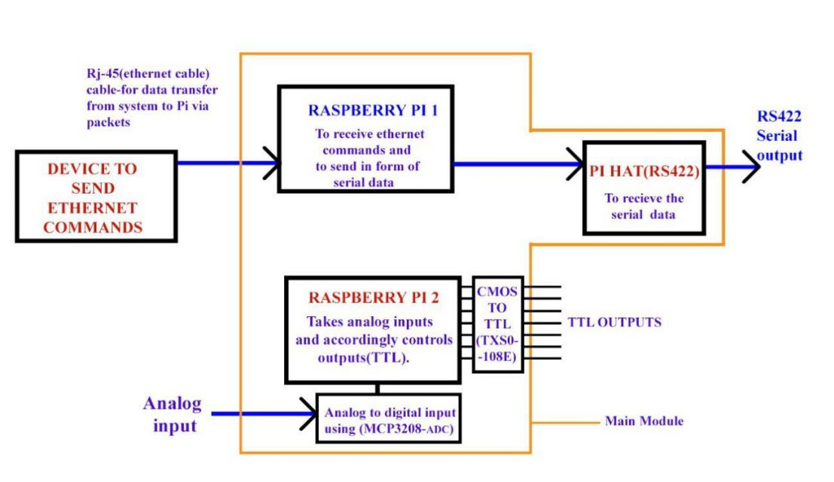
THE Second approach
This is the schematic diagram
representing implementation
of our project.
At the final stage, we were to cut
out unnecessary pin-outs as we
don’t have a PCB fabricating
machine.

Slide 6
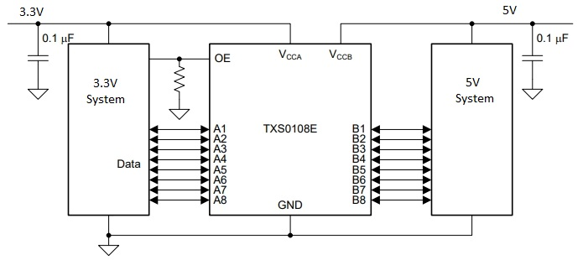
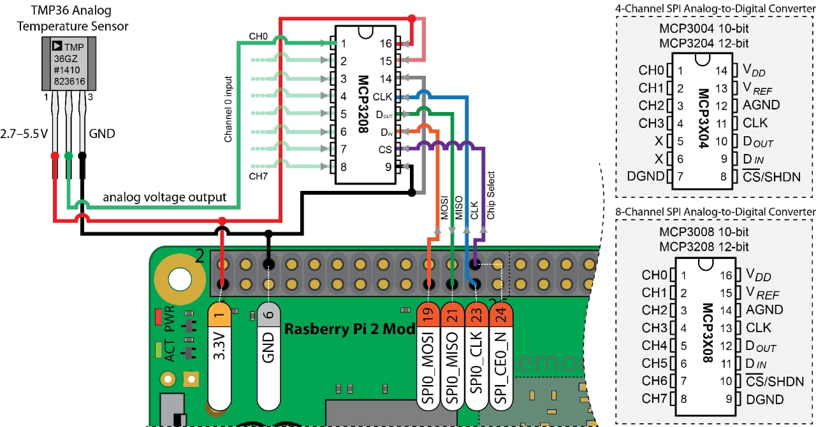
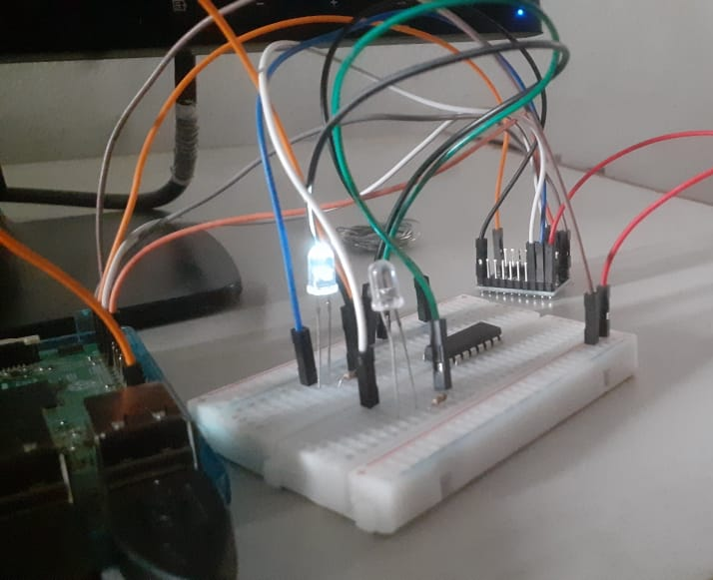
MODULES USED
Used MCP3208 as Analog to Digital Convertor
Used TXS0108E for CMOS to TTL logic
level conversion
C. LM35 or any sensor for that matter

Slide 7
OUTPUT VERSIONS
A. Raw python code.
After assembling the hardware components and isolating it, engineers may use it in
any manner. Like in a PLC or some other interface. So for them understand working
we’ve submitted the code.
B. Graphical User Interface Version.
This GUI is done by me additionally in Visual Studio ( C# - WinForms) for them to
easily execute in PC, without the need of installing python and its libraries.

Slide 8
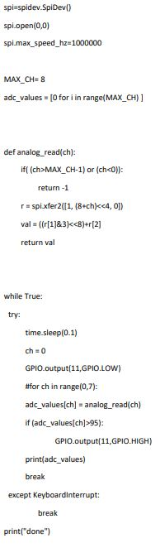
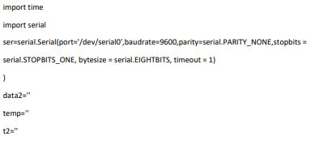
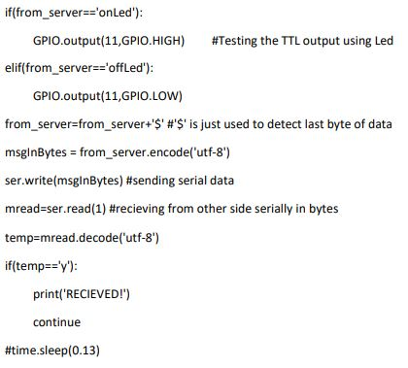
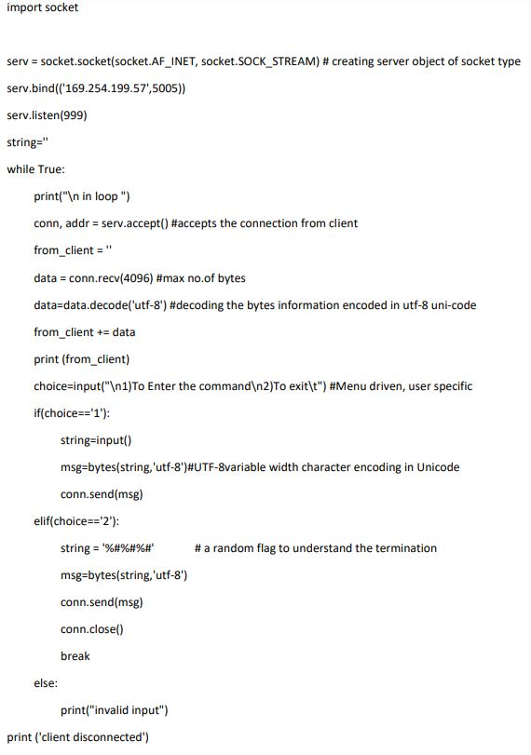
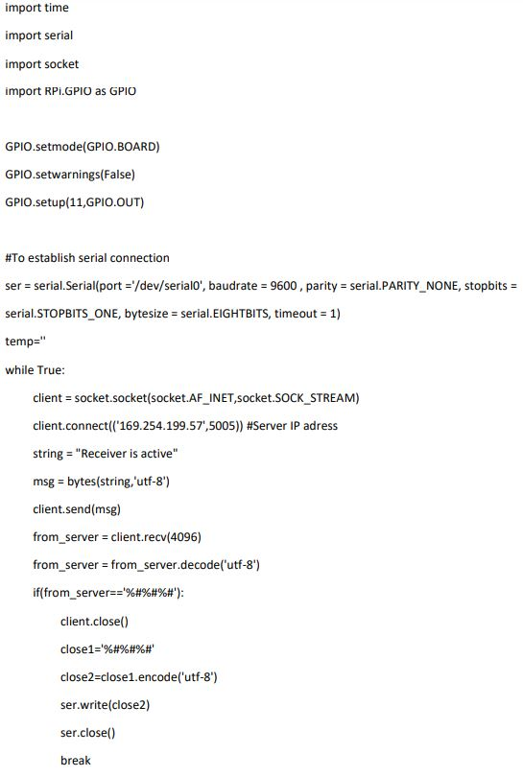
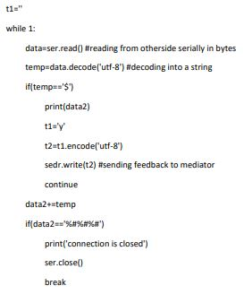
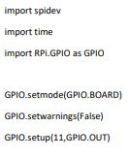
output versions - python

Slide 9
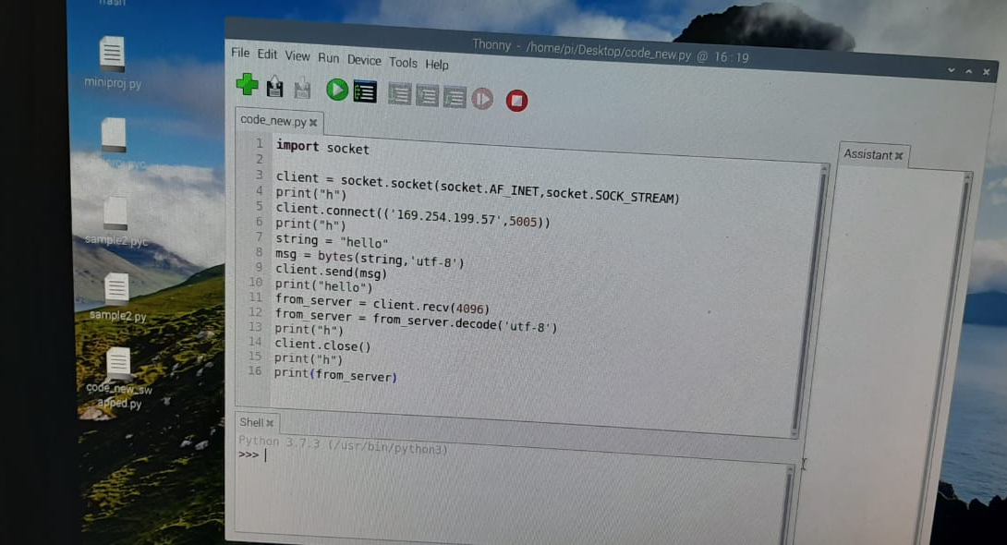
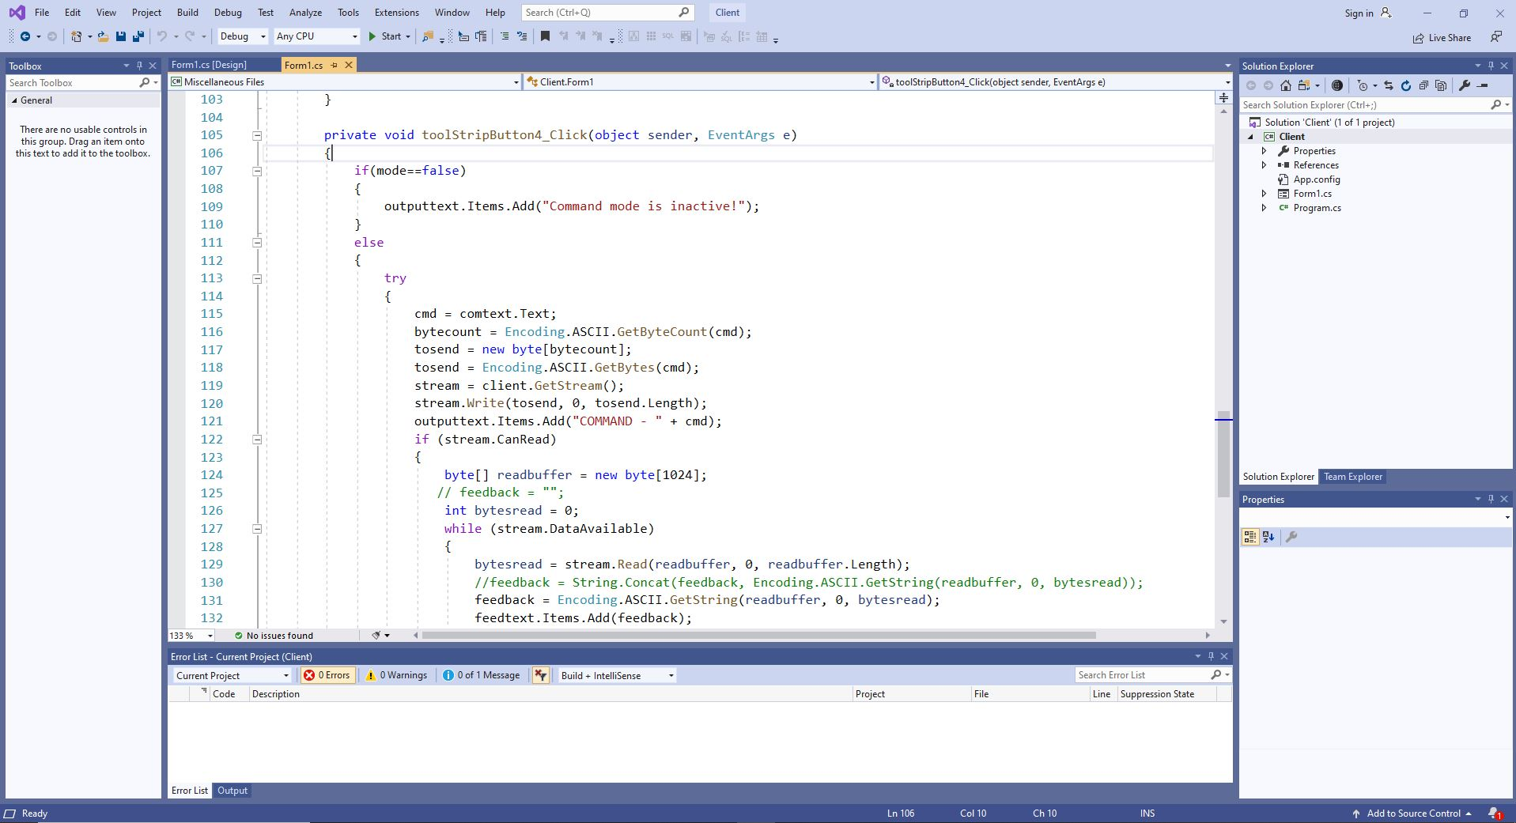
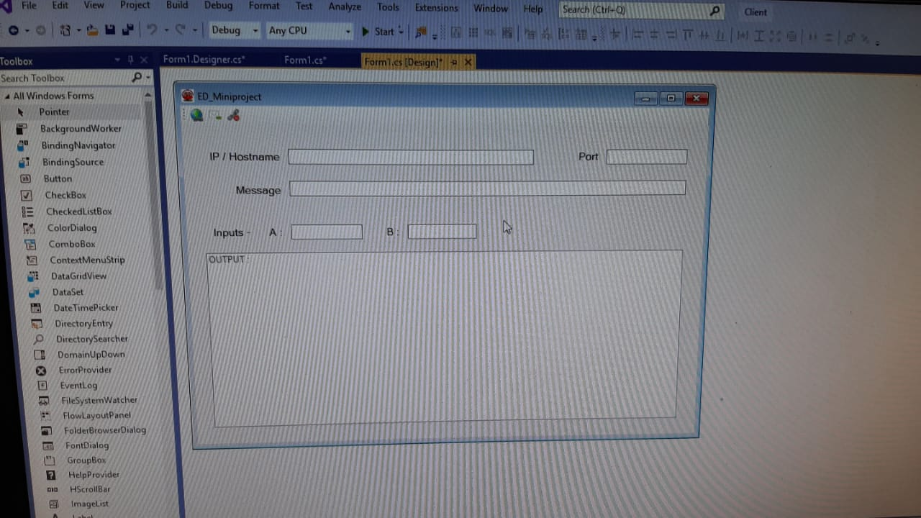
Output versions - GUI

Slide 10
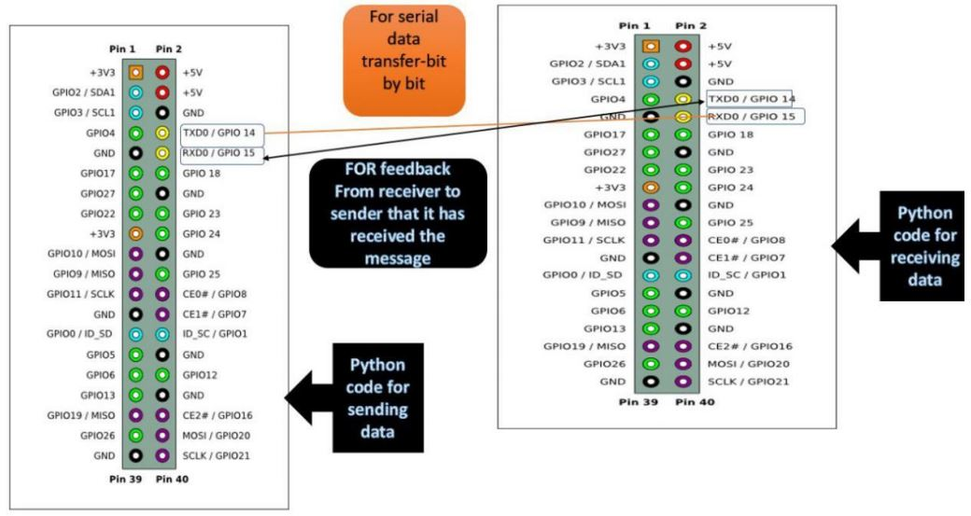
Testing
To test our module, we need to know
the source input type.
Now that it’s not known, we’ve used another raspberry pi to send inputs serially through UART ports. Then we verified that socket communication works well and with the convertors and level shifters, we get desired outputs.
We may also test it with GUI installed in other PC.

Slide 11
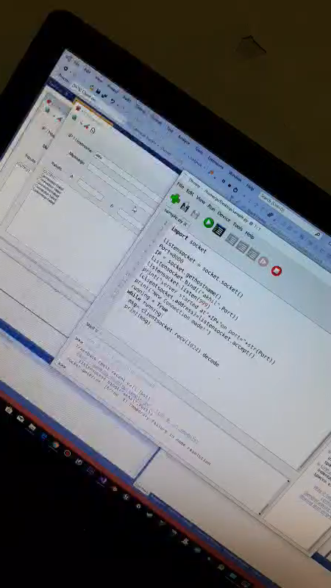
MY Contribution
Idea initiation
Mentoring classmates
Worked in every aspect for
project
Designed GUI version

Slide 12
Further Development
Both sub-modules can be integrated using multi-threading
Instead of stacking the Pi-HAT, the female header of Pi-HAT can be dissolved and only the required pins should be connected which in turn saves the GPIO pins of the central Raspberry Pi.

